Slide 1


Slide 2
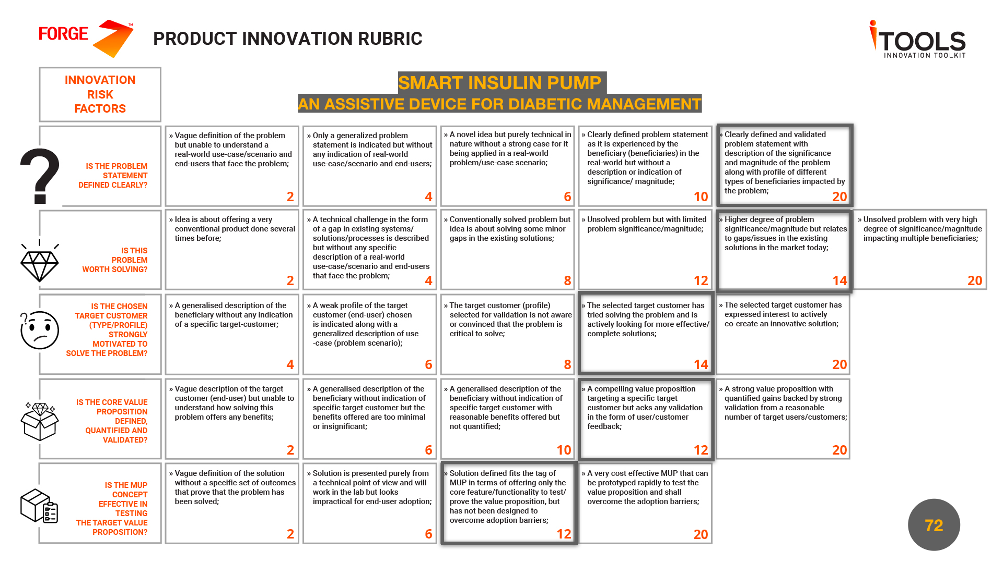

Slide 3
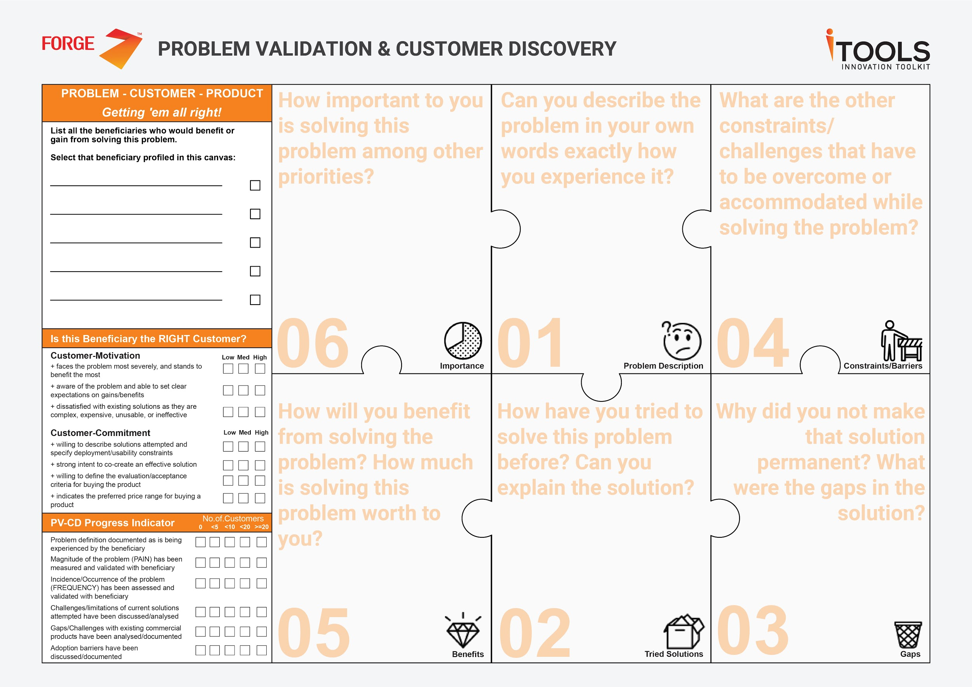
Doctors
Caretakers
Diabetic Patients
Giving them proper treatment and making patients lead a normal life is their primary job
Diabetic patients forget to take the right amount of insulin at the right time and hence the doctors find it difficult to have a continuous monitoring on the patient’s health
1. Easy to handle the instruments
2. Safe for use without assistance
1. Relieve patients from their complaints about BG levels
2. Better health support to patients
Minimised risk of and improved clinical outcomes
By interacting, prescribing and advising the patients
1. Patients forget their insulin shot
2. In case of irregularity patients tend to assume higher need for dose without consultation
3. Procrastination/lethargy

Slide 4
Doctors
Caretakers
Diabetic Patients
1. More than 62 million Indians, which is more than 7.1% of the adult population, are suffering from Diabetic Mellitus
2. Among them, most of the diabetes patients on an average take 3-4 injections per day.
3.Due to frequent injections,they experience a lot of mental stress and it causes also causes insecurity.
Diabetic patients forget to take insulin that are prescribed to them by the doctors and experience discomfort while doing so
1. Periodical prompts for medications
2. Should be less expensive
1. Maintaining a balanced glycemic level
2. Reduces the frequency of
Injections taken per day
3. Relief from the act of giving
incorrect insulin dosages
4. Extended life due to the precision in treatments
1. Taking insulin using
pills/inhalers
2. Insulin syringes/pens
3. Insulin Pumps
1. Swelling of arms and other
physical complications
2. Insulin pumps are too costly

Slide 5
Caretakers
Doctors
Caretakers
1.Social and Professional problems are nothing in compared to the illness of their cared ones.
2.If this problem is left unaccounted, may lead to the loss of their cared ones.
3. 62% of caregivers are facing mild depression and a higher incidence of anxiety [link proof]
1.Caring for child with Diabetes, requires constant vigilance
2.Carrying out a labour intensive and complicated daily regimen
3.Have to live with constant worry about glycemic conditions and heightened feelings of responsibility for the child’s health
Diabetic Patients
1.Keeping a constant track of the patients data 2.Changing modes of medication, Time, Food
1.Leaving work occasionally to assist the school with complications with the child.
2. Contacting the elderly/ children periodically to check whether they took their medications.
1.Disrupting professional life
2.Time consuming and involves stress
3.Cannot contact/reach them at all times.
1.Healthy profesional life
2. Reduced anxiety
3. Healthy family life, leading to increased Family Outcomes

Slide 6
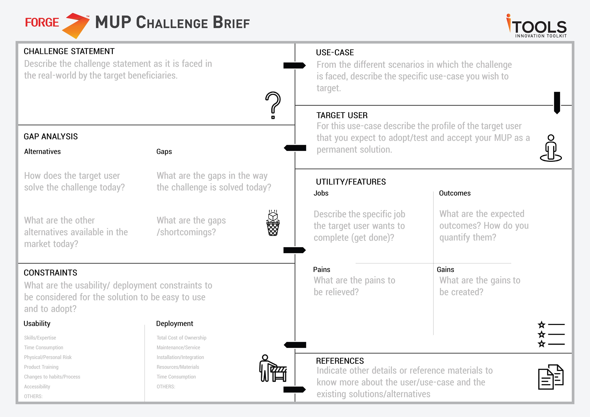
Diabetic patients face the problem of forgetting to take insulin at the right time or take wrong dosage of insulin, thereby creating difficulties for the doctors to monitor the patient’s health progress
Diabetic patients are required to take on an average of 4-5 injections per day. Most of the time they either forget to take the insulin or take over dosage of it and hence the doctors are unable to continuously monitor the patient’s health.
Diabetic patients who need regular dosage of scheduled insulin (Type I and Type II)
Patients:
1. Insulin Syringes and pens, 2. Insulin Patches 3. Insulin pumps,
4. Oral Insulin 5. Nasal Insulin
Doctors:
1. Patients forget to take in the right amount of insulin
Patients:
1. Need to remember the right dosage of the insulin and prone to human error
2. Insulin Pumps are too expensive
3. Side effects
Doctors:
1. Unable to track the progress in the patient’s health
Patient:
To take in the right amount of insulin dosage at the right time
Doctor:
To check for the patient’s health progress regularly
Patient:
Balanced blood glucose level
Doctors:
Proper unbiased data from patients
Medtronics Minimed 630G/670G
T-slim X2 by Tandem
OmniPod
Roche:Accu-Chek
Patient:
1. Effort-ridden and discomfort in using syringes/pens
2. Not necessary to remember the insulin dosage
Doctor:
No more advising / meeting the patients regularly
Patient:
1. Cost effective solution
Doctors:
Improved Diagnostics and Treatment
1. Skills / Expertise
2. Change of habits
3. Physical or personal risk
4. Product training
1. Total cost of ownership
2. Maintenance/Service
3. Integration with the patient’s body

Slide 7
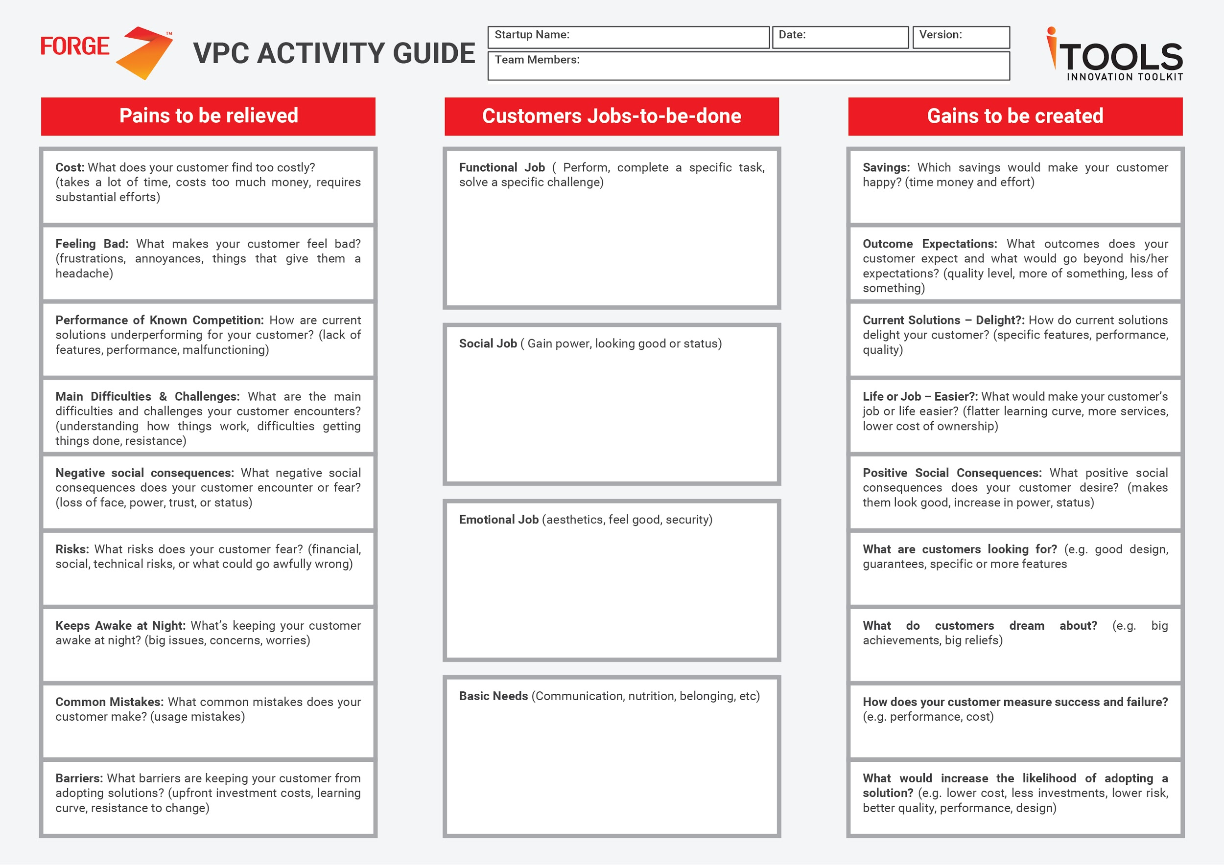
Frustrations due to continuous injection of insulin
The effort to remember the right dosage of insulin
Patients to take the right amount of insulin at the right time.
Doctors to continuously monitor the patient’s health
Swelling of hands or any other physical complications
Precise amount of insulin intake into the patient’s body
Forgetting to take insulin at the right time
Inferiority Complex while using the insulin in public places
Reduced Number of injections
Insulin injection into the body without any major side effects
Taking in wrong dosage of insulin
Learning curve for the patients
Low cost of investment

Slide 8
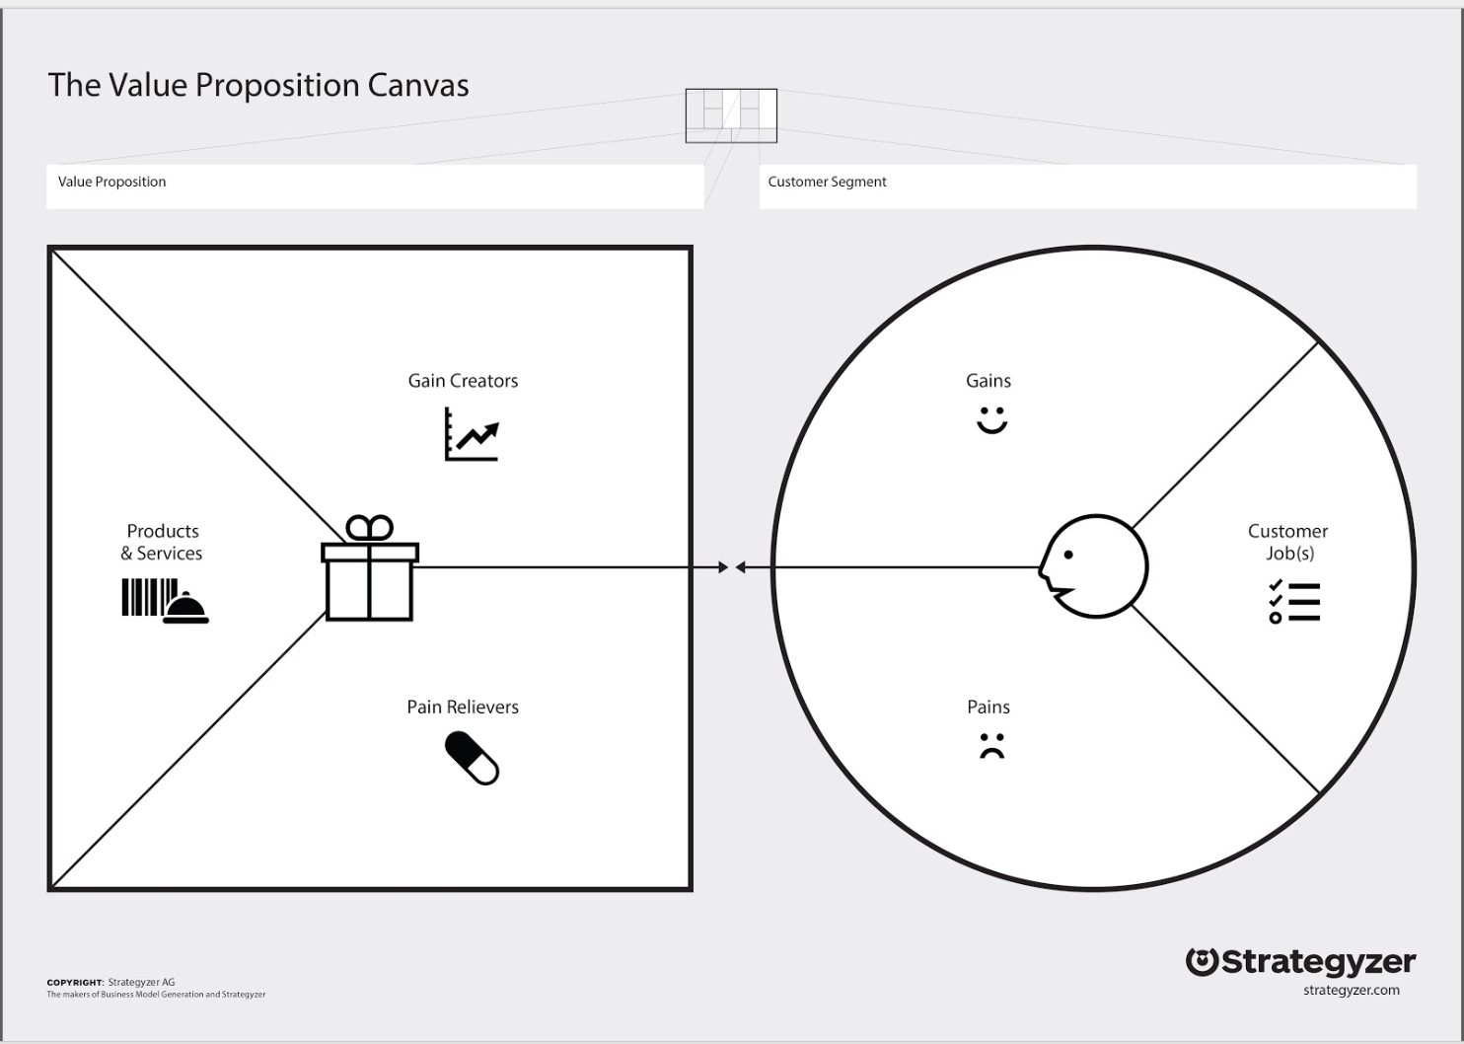
1. Can regulate the insulin amount according to the needs.
2. Single injection required for 3 days
3. Regulated insulin along with data given, being monitored by the doctor
4. Unified device
Reduced Number of injections
Prevention from worsening of the disease with proper following of treatments
Better social appearance among peers
1. A Semi-automated Insulin Pump that delivers insulin at pre-programmed dosages and intervals
2. Continuous monitoring of the patient’s health and pump status through a mobile application to the doctors
Patients to take the right amount of insulin at the right time
Doctors to continuously monitor the patient’s health
1. Less probability of damaging skin instead of syringe/shot
(Injection reduction ratio 12:1)
2. Reduced to 1 injection per 3 Days
3. Accurate amount of Insulin being sent on hourly basis, according to that that days needs
4. Smart device with a touch screen
5. Simplified UI for the patient
Frustrations due to continuous injection of insulin
Swelling of hands or any other physical complications
Forgetting to take insulin at the right time.
Inferiority Complex while using the insulin in public places
Taking in wrong dosage of insulin
High cost of investment for alternatives
Requires Immense product training

Slide 9
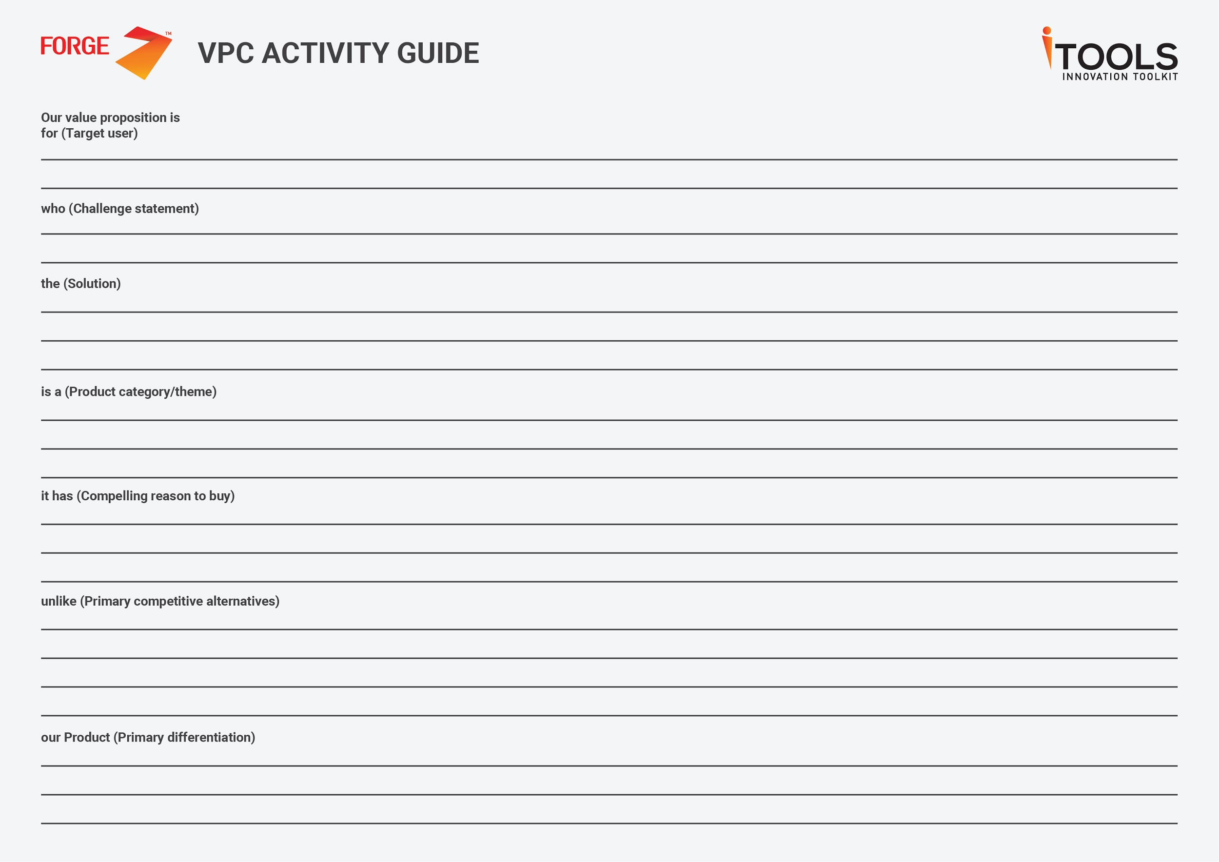
Diabetic Patients and Diabetologists
Diabetic patients forget to take the right amount of insulin at the right time and hence the doctors are unable to track the progress in their patient’s health
An insulin pump that provides continuous flow of insulin into the patient’s body at regular intervals.
IOT-Intelligent Machines
Delivery of insulin at pre-programmed dosages and interval.
Insulin Syringes and pens ,Nasal Insulin, Insulin Patches, Insulin pumps, Oral Insulin
Sharing Pump/Patients status in a mobile application to the doctors
Reducing the social awkwardness for the patients.

Slide 10
Value Proposition
Smart Insulin Pump provides prolonged diabetic patients to manage their insulin treatment through a pre-programmed precise insulin delivery mechanism enabling 24x7 monitoring of dosage intake, notification system with refill alert and indication to caretaker/doctor of missed intake.

